Slide 1
Data Ingestion
Emanuele Della Valle
Prof. @ Politecnico di Milano
Founder & Partner @ Quantia Consulting
Marco Balduini
Founder & CEO @ Quantia Consulting
Riccardo Tommasini
Prof. @ University of Tartu

Slide 2
Introduction

Slide 3
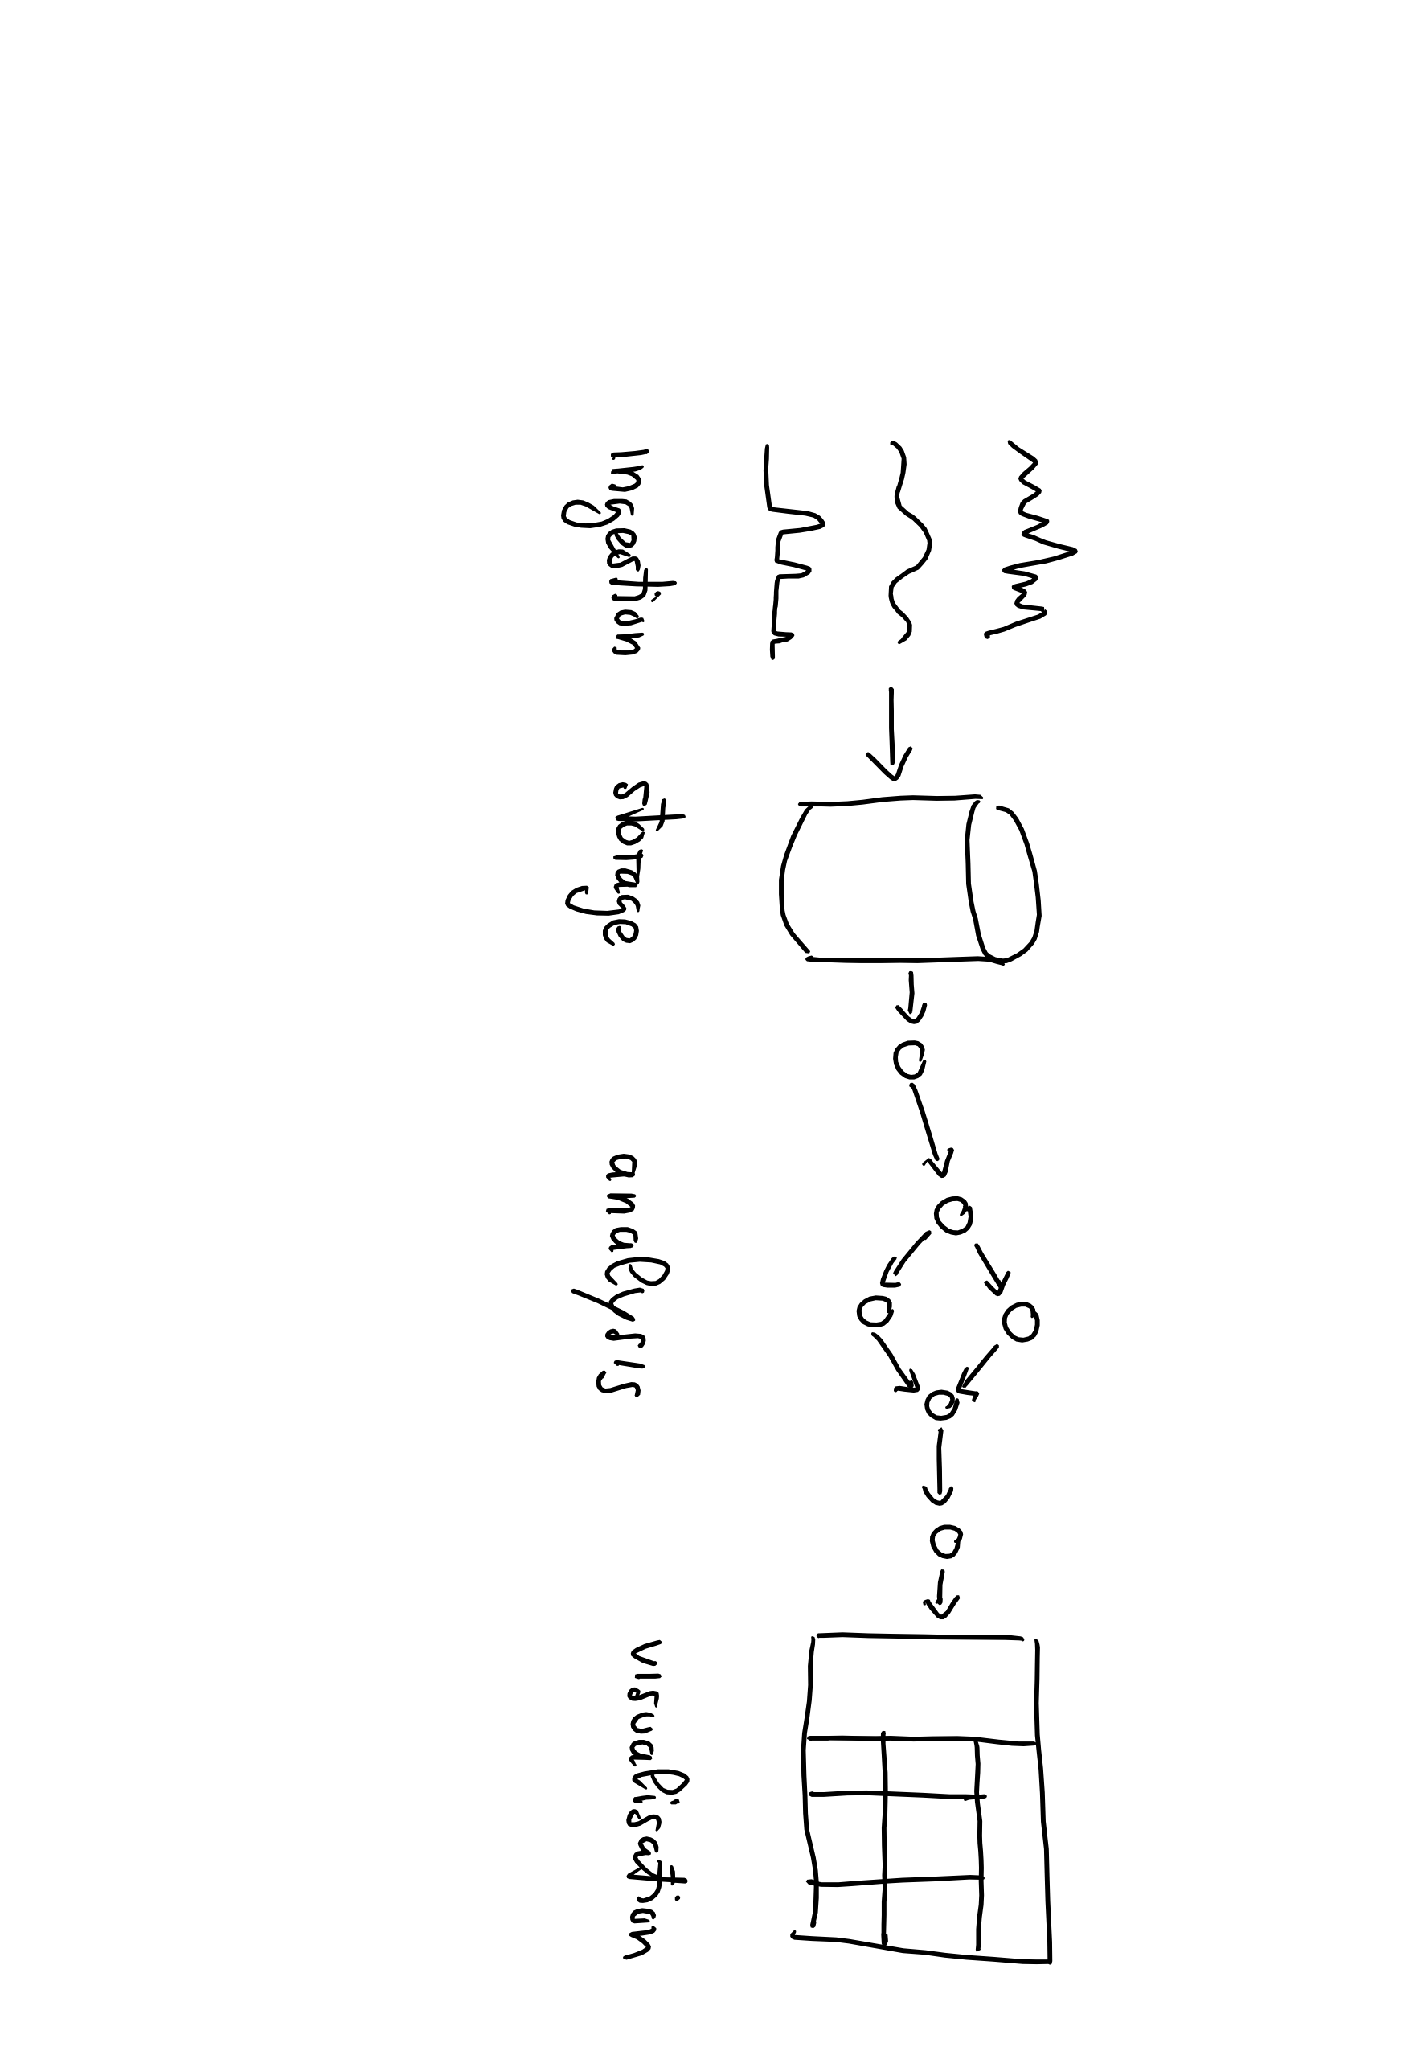
Data Lifecycle

Slide 4
Data Lifecycle

Slide 5
Data Lifecycle

Slide 6
How is data ingested?

Slide 7
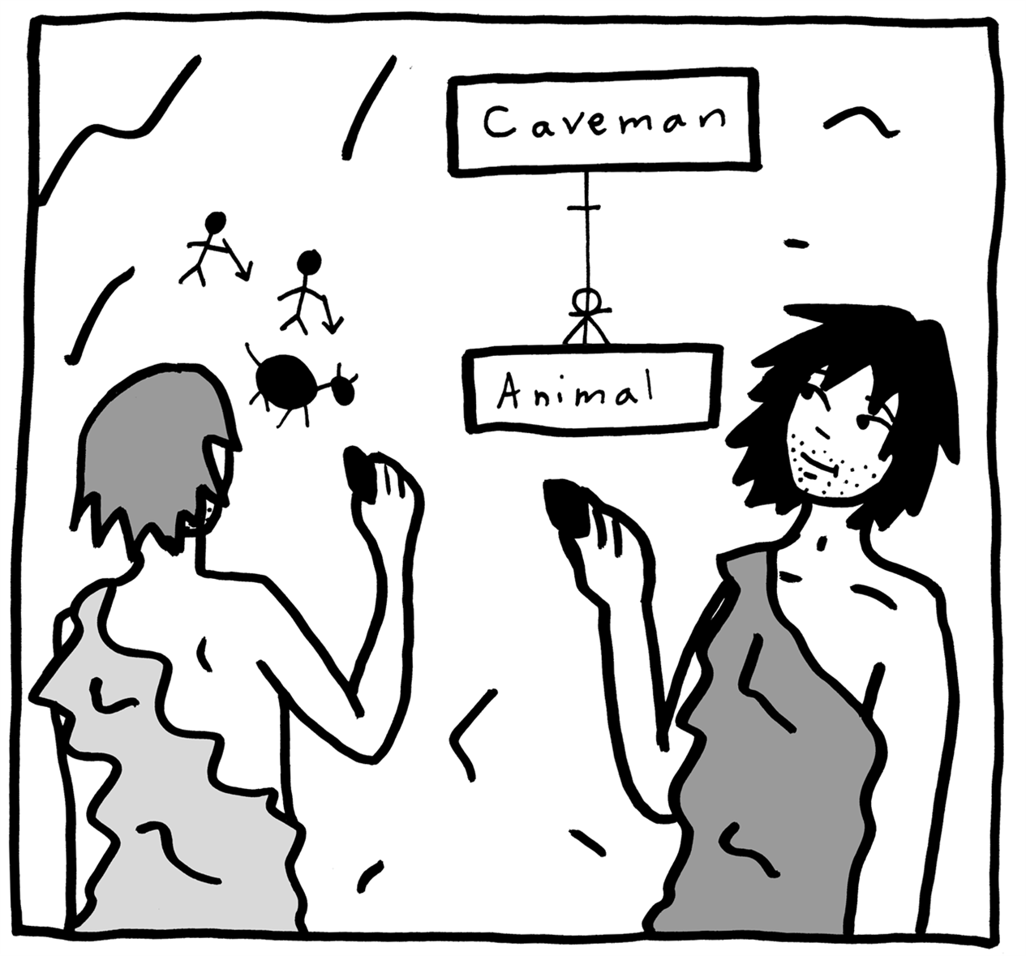
Conceptual vs. logical vs. physical views
[Src: https://www.oreilly.com/library/view/data-modeling-made/9781935504481/ ]

Slide 8
How is data ingested? Conceptual View

Slide 9
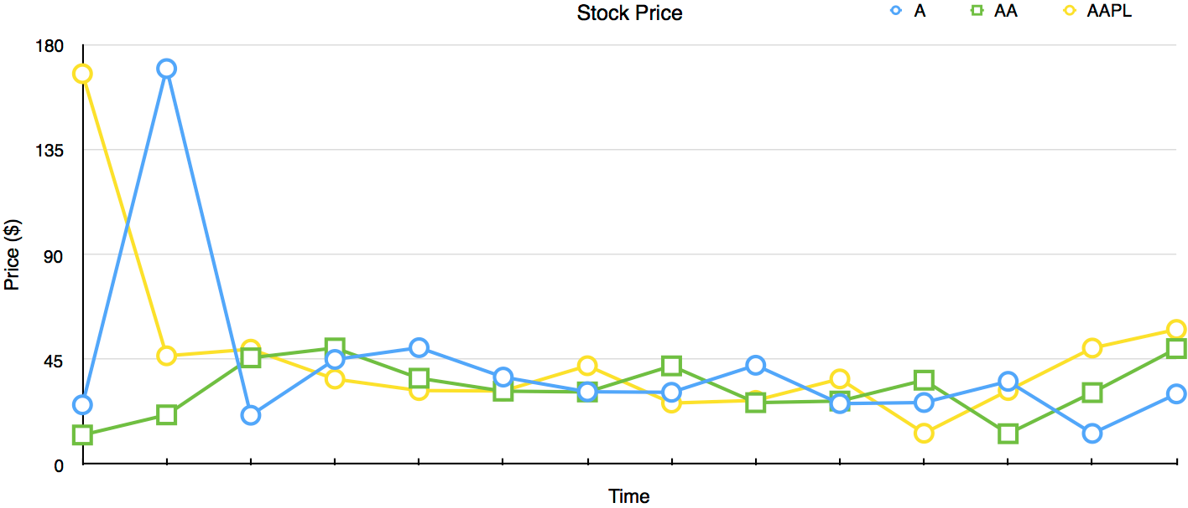
Let’s start from the anatomy of a Time-Series Line Graph

Slide 10
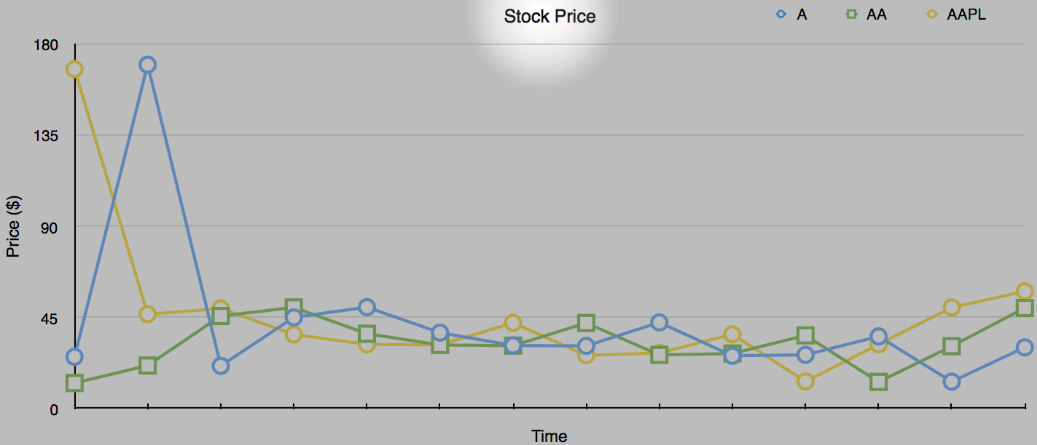
The type of measurement is the title of the Line Graph

Slide 11
Data Model
Measurement
The name of the measurement used as high level grouping of data
Tag set
Other lower level grouping criteria of data
Fields
Actual data
Timestamp
Time of the data
Series
A unique combination of measurement+tags

Slide 12
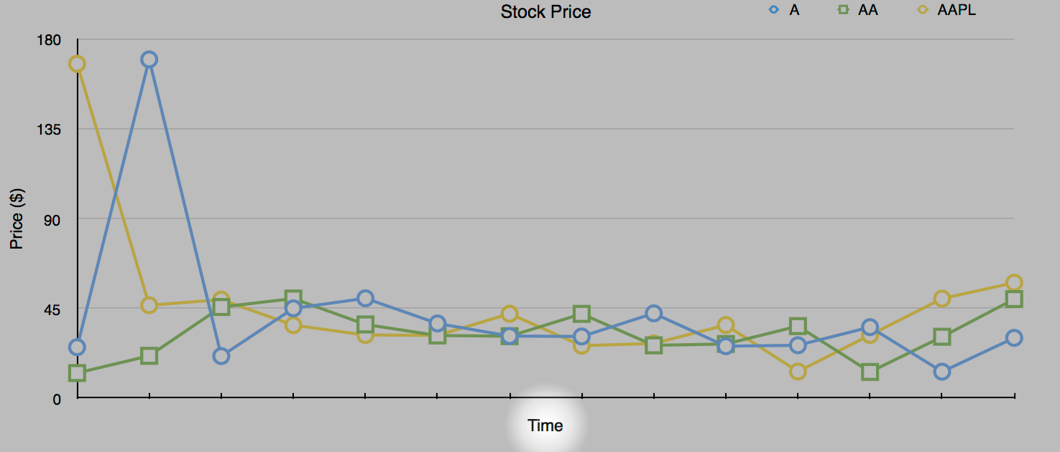
Time stamps are on the X-Axis

Slide 13
Data Model
Measurement
The name of the measurement used as high level grouping of data
Tag set
Other lower level grouping criteria of data
Fields
Actual data
Timestamp
Time of the data (better if the time the data is observed)
Series
A unique combination of measurement+tags

Slide 14
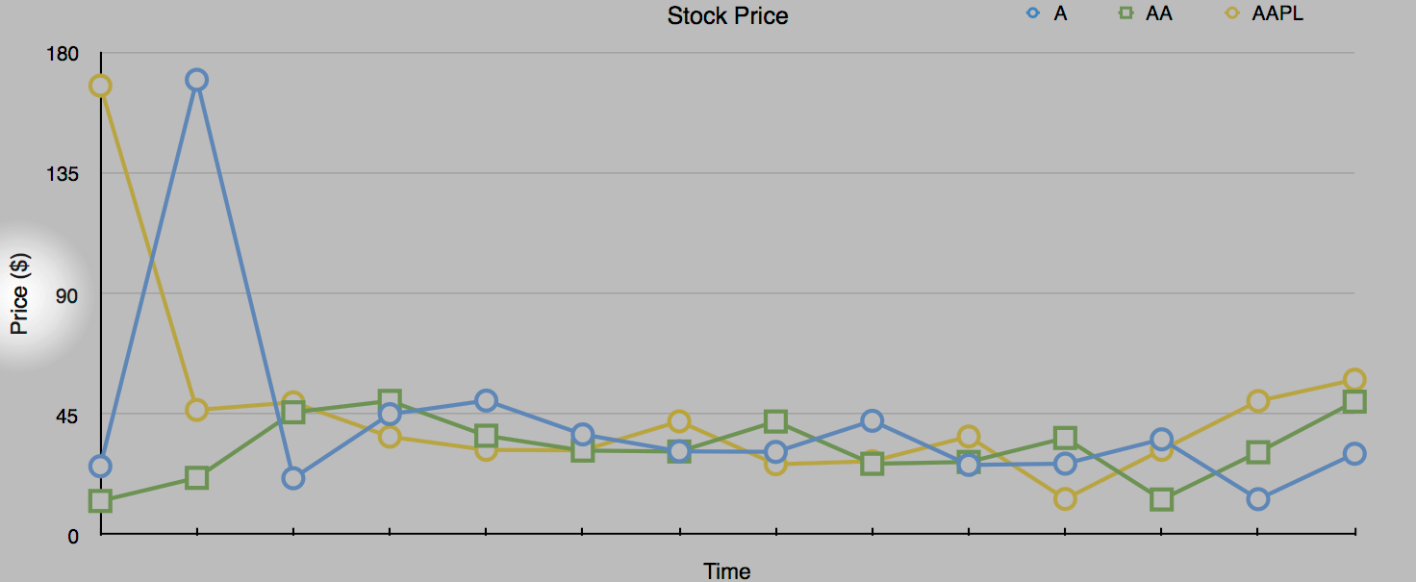
Data is on the Y-Axis

Slide 15
Data Model
Measurement
The name of the measurement used as high level grouping of data
Tag set
Other lower level grouping criteria of data
Field set
Actual data
Timestamp
Time of the data (better if the time the data is observed)
Series
A unique combination of measurement+tags

Slide 16
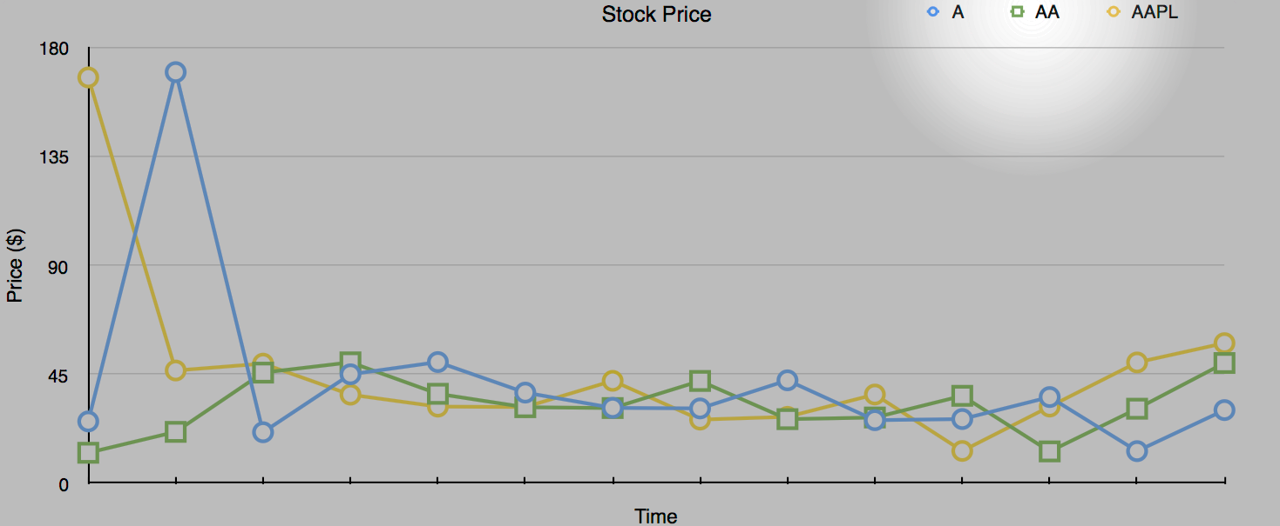
The Legend distinguishes the three time series in the graph

Slide 17
Data Model
Measurement
The name of the measurement used as high level grouping of data
Tag set
Other lower level grouping criteria of data
Field set
Actual data
Timestamp
Time of the data (better if the time the data is observed)
Series
A unique combination of measurement+tags

Slide 18
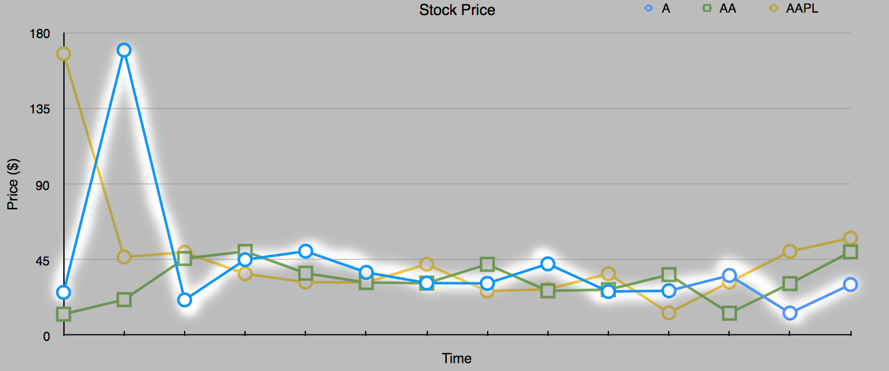
A series in the graph thus is …

Slide 19
Data Model
Measurement
The name of the measurement used as high level grouping of data
Tag set
Other lower level grouping criteria of data
Field set
Actual data
Timestamp
Time of the data (better if the time the data is observed)
Series
Data points in time order grouped by measurements and tags

Slide 20
How is data ingested? Logical View

Slide 21
Data Model
Measurement
A name to group data at high level
Tag set
A set of key-value pairs to group data at low level
Field set
A set of key-value pairs to represent data
Timestamp
Time of the data with nanosecond precision
Series
A unique combination of measurement+tags

Slide 22
Data model vs ingestion & storage
Series
Buckets
(set of series)
Measurement
Tag set
Field set
Timestamp

Slide 23
How is data ingested? Physical View

Slide 24
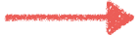
An example of Line Protocol
cpu,host=serverA,num=1,region=west idle=1.667,system=2342.2 1492214400000000000
Measurement

Slide 25
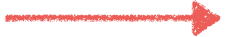
An example of Line Protocol
cpu,host=serverA,num=1,region=west idle=1.667,system=2342.2 1492214400000000000
Tags

Slide 26
An example of Line Protocol
whitespace
cpu,host=serverA,num=1,region=west idle=1.667,system=2342.2 1492214400000000000
Tags

Slide 27
An example of Line Protocol
cpu,host=serverA,num=1,region=west idle=1.667,system=2342.2 1492214400000000000
Fields

Slide 28
An example of Line Protocol
whitespace
cpu,host=serverA,num=1,region=west idle=1.667,system=2342.2 1492214400000000000
Fields

Slide 29
An example of Line Protocol
cpu,host=serverA,num=1,region=west idle=1.667,system=2342.2 1492214400000000000
timestamp
Reference: https://v2.docs.influxdata.com/v2.0/reference/line-protocol/

Slide 30
Bucket physical view
Columnar Data Stores
Best for column selection and aggregation thanks to
Disk + Memory locality
Cache locality
_time
_m
host
num
region
idle
system
1492…1
cpu
serverB
1
west
1.667
2342.2
1492…0
cpu
serverA
1
west
1789.4
2.779
…
…
…
…
…
…
…
_m = _measurement
tags
fields

Slide 31
So, the line protocol representations of two metrics are …
stock_price,ticker=A price=170 1465839830100400200
stock_price,ticker=AA price=42 1465839840100400200

Slide 32
How is data automatically ingested?

Slide 33
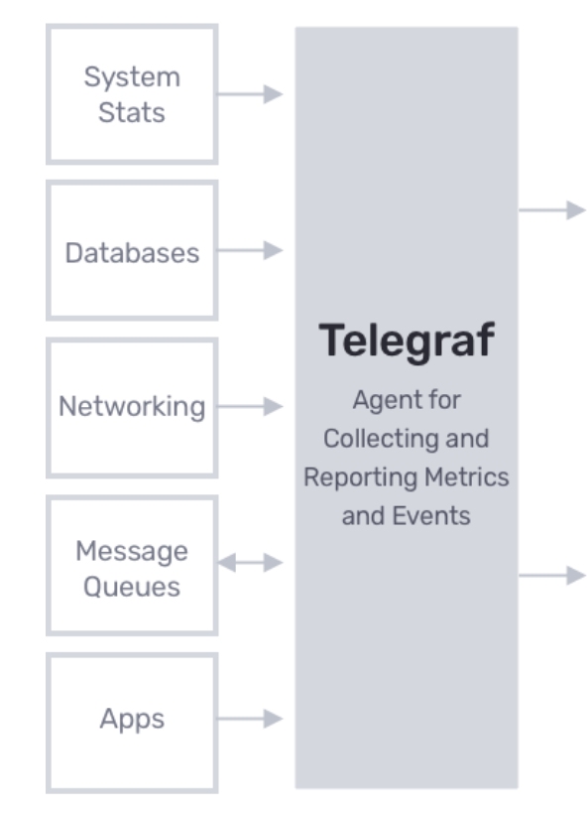
Telegraf
Telegraf is a data collection agent
It is based on a Plug and Play architecture
It offers a variety of input plugins
It can be configured from the InfluxDB cloud UI
Download and install: https://docs.influxdata.com/telegraf/latest/introduction/installation/

Slide 34
Positioning Telegraf in the ingestion pipeline
Telegraf

Slide 35
Quiz
Provide the correct relationship — 1:1, 1:N, N:1, or N:N
a time series to a measurement — ?
a time series to a tag — ?
a time series to a field name — ?
a field name to a field value — ?
a time series to a timestamp — ?
a <measurement,tag,field name,timestamp> to a value — ?

Slide 36
Quiz answers
Provide the correct relationship — 1:1, 1:N, N:1, or N:N –
a time series to a measurement — 1:1
a time series to a tag — 1:N
a time series to a field name — 1:N
a field name to a field value — 1:N
a time series to a timestamp — 1:N
a <measurement,tag,field name,timestamp> to a value — 1:1

Slide 37

Let’s get dirty!
1

Slide 38
Use Case: Continuous Linear Pizza Oven
Sensors observe
temperature (C°)
relative humidity (%)
of the two ovens
Learning Goals
Line protocol usage
First query
s2
s1
mozzarella melting area
base cooking area

Slide 39
Task 1
Model the following data representing the temperature and the humidity observations, from both sensors, over time.
component | sensor | temperature | humidity | ts
iot-oven | S1 | 290 | 30 | 1569888000000000000
iot-oven | S2 | 105 | 55 | 1569888015000000000
iot-oven | S1 | 305 | 38 | 1569888060000000000
iot-oven | S2 | 120 | 65 | 1569888075000000000

Slide 40
Task 2
Run you first query
from(bucket: "training")
|> range(start: 2019-10-01T00:00:00Z, stop: 2019-10-01T00:05:00Z)
|> filter(fn: (r) => r._measurement == "iot-oven")
|> filter(fn: (r) => r._field == "temperature")
|> filter(fn: (r) => r.sensor == "S2")
|> filter(fn: (r) => r._value < 100)

Slide 41
Quiz
Should a bucket contain the same number of distinct measurements, tag names, tag values, field names, field values, and timestamps the same?
If not, can you order them? use:
>> (much more than)
~ (around the same)
e.g., field values >> field names

Slide 42
Quiz answers
Should a bucket contain the same number of distinct measurements, tag names, tag values, field names, field values, and timestamps the same?
If not, can you order them? use:
>> (much more than)
~ (around the same)
ts >> field values >> tag values >> field names ~ tag names >> measurements

Slide 43
Data Ingestion
Emanuele Della Valle Prof. @ Politecnico di Milano & Partner @ Quantia Consulting
Marco Balduini Founder & CEO @ Quantia Consulting
Riccardo Tommasini Prof. @ University of Tartu

